Slide 1

RAPS CONVERGENCE 2026
Regulatory Intelligence.
Reimagined.
The only platform purpose-built for medical device regulatory professionals
— from first market to global scale.
🏛️ RAPS Convergence 2026
regdesk.co
© RegDesk 2026 — All Rights Reserved
© RegDesk 2026 · regdesk.co

Slide 2
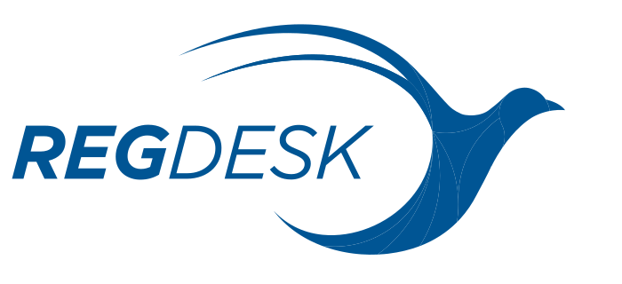
THE REGDESK PLATFORM
Four Pillars of Regulatory Excellence
🗺️
🔧
📊
🛡️
Plan
Build
Track
Maintain
Map regulatory pathways across 120+ markets. AI-powered classification and submission strategy — before you commit resources.
Compile compliant submissions with labeling requirements, UDI management, and automated document workflows.
Monitor registrations, renewals, and approvals across your entire portfolio. Real-time dashboards and renewal alerts.
Stay ahead of regulatory changes with automated impact assessments. Audit-ready documentation at every step.
Plan · Build · Track · Maintain
© RegDesk 2026 · regdesk.co

Slide 3
INTELLIGENT RIM
AI-Powered Regulatory Intelligence Engine
01
02
03
04
Change Impact Assessment
Smart Classification
Automated Alerts
Regulatory Co-Pilot
Automatically detect regulatory changes and instantly assess impact across every product, SKU, and market in your portfolio.
AI-driven device classification across 120+ markets. Instantly determine your regulatory pathway before committing resources.
Never miss a renewal or regulatory update. Real-time monitoring with intelligent notifications mapped to your portfolio.
AI-assisted labeling review, document summarization, and workflow automation — your regulatory team, supercharged.
AI-Driven Regulatory Intelligence
© RegDesk 2026 · regdesk.co

Slide 4
ENTERPRISE-GRADE VALIDATION
✓
Built for Audit.
Ready for Review.
Audit-Ready by Design
Not retrofitted. Built from the ground up for regulatory validation.
Full audit trails— Every action, document, and approval automatically captured
GxP compliance— Supports Good Practice guidelines including electronic records
21 CFR Part 11— Electronic signature and records compliance built-in
100%
GxP
Part 11
Change management— 4-stage validated workflow from assessment to approval
Automated Audit Trail
Compliance Supported
21 CFR Ready
Role-based access control— Enterprise identity and permissions management
SSO & multi-tenant workspaces— Secure collaboration across your organization
Enterprise Validation & Compliance
© RegDesk 2026 · regdesk.co

Slide 5
TRUST & COMPLIANCE
Security You Can Count On.
Compliance You Can Prove.
Enterprise-grade security infrastructure protecting your most sensitive regulatory data — certified, validated, and auditable.
🔒
🛡️
📋
✅
SOC 2 Type II
ISO 27001
21 CFR Part 11
GxP Compliant
Independently audited security controls. Your data is protected by the gold standard in enterprise security.
International standard for information security management systems — verified and maintained.
Electronic records and electronic signatures compliance for FDA-regulated environments.
Supports Good Practice guidelines including full audit trails and electronic records management.
SOC 2 · ISO 27001 · 21 CFR Part 11 · GxP
© RegDesk 2026 · regdesk.co

Slide 6
GLOBAL SCALE
Trusted at Scale
120+
250K+
$2.2B
Mid-Market
& Enterprise
Markets Covered
Full regulatory depth, not just alerts
Products Managed
Across global portfolios
Market Size (2024)
Growing to $6.2B by 2034
Client Size
Purpose-built for scaling med-dev teams
120+ Market Content Database
Device-Focused by Design
Distributor Collaboration Tools
Deep regulatory guidance — not surface-level alerts. The only platform with this level of device-specific depth.
Purpose-built for medical device manufacturers — not repurposed pharma software. Every feature for device teams.
Unique in-platform distributor workflow management. A genuine differentiator no competitor has matched.
120+ Markets · 250K+ Products · Purpose-Built for MedDev
© RegDesk 2026 · regdesk.co

Slide 7
THE REGDESK DIFFERENCE
WITHOUT REGDESK vs. WITH REGDESK
From First Market
to Global Scale —
❌ Manual tracking in spreadsheets — error-prone, not scalable
✅ Real-time portfolio dashboard across all markets
❌ Missed renewals discovered late — costly delays
✅ Automated alerts months in advance, every time
In One Platform.
❌ Regulatory changes discovered months after the fact
✅ AI impact assessment the moment a change is published
Most teams manage regulatory with spreadsheets, email threads, and outdated PDFs.
RegDesk replaces all of it — with a system that scales with you.
Regulatory Intelligence Redefined
© RegDesk 2026 · regdesk.co

Slide 8
INTEGRATIONS & ECOSYSTEM
🔗
⚙️
Fits Into Your
Existing Stack.
REST API
ERP / PLM
Full read/write access
SAP & enterprise systems
✅
🔐
API access— Read/write API to integrate RegDesk into your existing tech stack
QMS
SSO
ERP / PLM integration— SAP, PLM, eDMS, and enterprise systems
Quality management sync
Enterprise identity
QMS / eQMS integration— Bi-directional sync with quality management systems
🏷️
SSO / enterprise auth— SAML, OIDC, and enterprise identity providers
UDI Management
UDI management— GUDID and EUDAMED integration
GUDID + EUDAMED integration
Integrate RegDesk Into Your Existing Tech Stack
© RegDesk 2026 · regdesk.co

Slide 9
Trusted by Regulatory Professionals
RAPS CONVERGENCE 2026 · VISIT OUR BOOTH
Ready to Transform Your
Regulatory Operations?
Speak with our regulatory intelligence experts today.
See how RegDesk can help your team move faster, stay compliant, and scale globally.
regdesk.co
120+ Markets
SOC 2 · ISO 27001
Schedule a Demo
Full Regulatory Depth
Enterprise Security
© RegDesk 2026 — Regulatory Intelligence Reimagined
© RegDesk 2026 · regdesk.co

